Slide 1
Quantum Noise and Error Correction
Rajesh Sathya Kumar

Slide 2
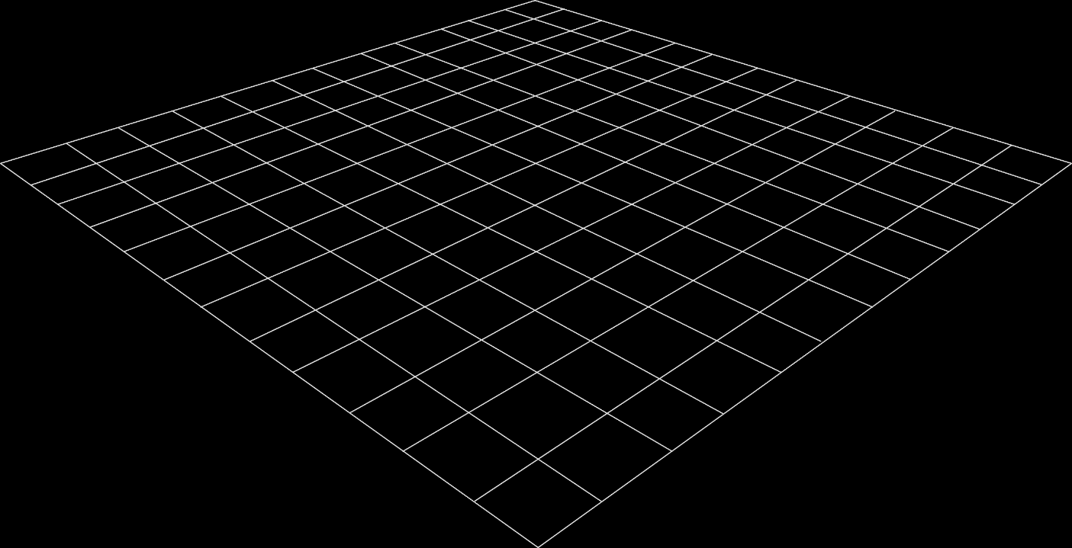
Terminologies
Quantum Noise
Noise describes all the things that can cause the quantum computers to malfunction. The source of quantum noise includes electromagnetic signals, earths magnetic field, due to which the qubit states inherently changes slightly from its original state
Decoherence
This change in the qubit state due to environmental factors is called decoherence of qubits

Slide 3
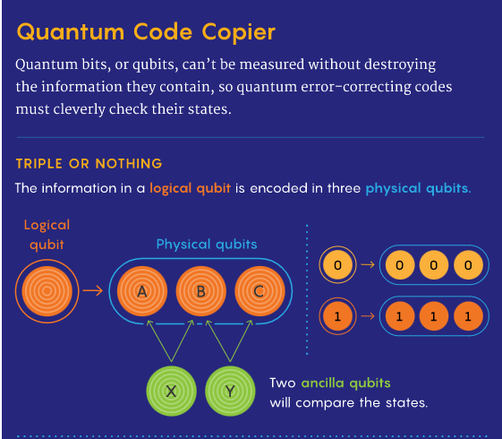
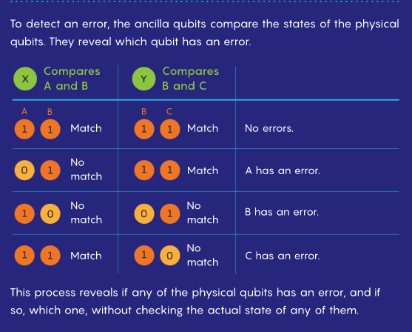
Error Correction using Repetition

Slide 4
Quantum Distance Measures
In general, a distance measure quantifies the extent to which two quantum states behave in the same way. While these distance measures are usually given by certain mathematical expressions, they often possess a simple operational meaning, i.e., they are related to the problem of distinguishing two systems.
References
1. J. Chiaverini, D. Leibfried, T. Schaetz, M. D. Barrett, R. B. Blakestad, J. Britton, W. M. Itano, J. D. Jost, E. Knill, C. Langer, R.
Ozeri, and D. J. Wineland, “Realization of quantum error correction,” Nature, vol. 432, no. 7017, pp. 602–605, 2004.
2. J. ROFFE, “The Coherent Parity Check Framework for Quantum Error Correction,” Durham University, 2019.

Slide 5
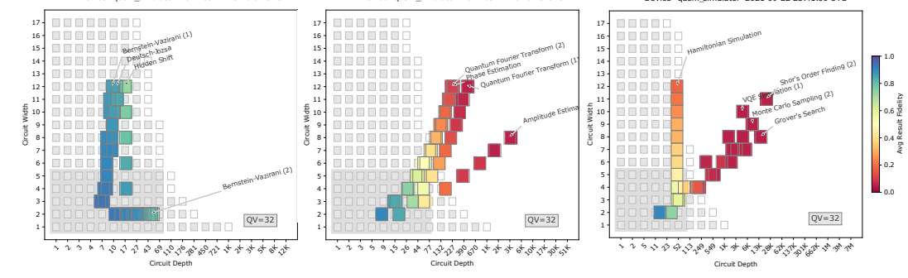
Progress this week
Studying Quantum Noise and Error Correcting techniques using Repeating codes
Checking on the implementation of error correction techniques
Implementation of Quantum Volume and Measuring CLOPS (across different platforms) as a separate python library
Plan for next week:
Continue working on the implementation of quantum algorithms benchmarks
Studying on distance measures and other error mitigation techniques

